Slide 1
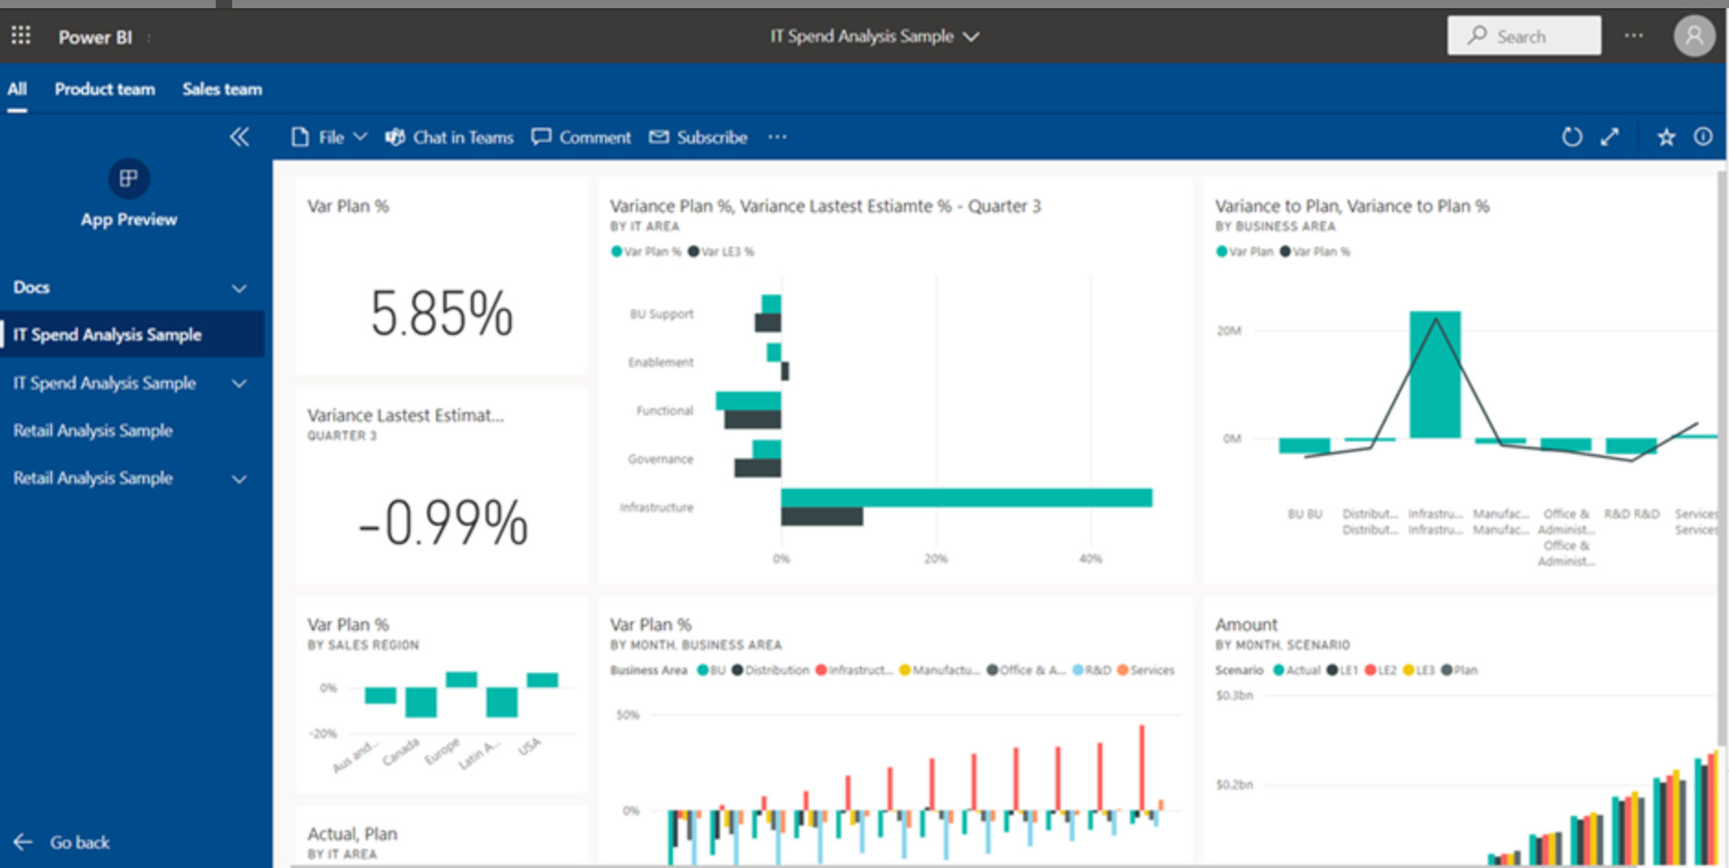

PowerBI App Powered Finance Reporting Hub Prototype
Sales & Margin Reporting
Finance team
S&OP team
Audit – Internal & External
NOTES:
A Power BI App provides a secure, scalable, and governed single access point for consolidating Finance dashboards, improving usability, control, and adoption.
1. Single Entry Point for Users
One app URL provides access to all Finance dashboards.
Eliminates confusion caused by multiple report links.
Improves adoption and ease of use for global users.
2. Clear, Structured Navigation
Logical hierarchy: App → Reports → Pages.
Users can quickly navigate between:
Global Sales
Inventory
Spend Analysis
Reduces training and support effort.
3. Centralized Access Control
Permissions managed at the app level.
Supports:
Role-based access (Executives, Finance, Audit)
Region-based visibility (via RLS)
Ensures sensitive financial data is properly governed.
Sales Reporting
Daily Sales
Illustrative
Margin Analysis
Expense Reporting
Inventory Reporting

Slide 2
Global Daily Sales Reporting

Slide 3
Key Metrics Required
company
TType
Order No
Order Date
Po No
Customer Order No
Invoice
Date
Item
Item desc
Custcode
Cust Name
DPST
Dpstname
Area
Areaname
Organ
Region
User names
Vertical1
Zone
Order Type
sales category
Fin Cust Grp
Delivery Qty
Emp Code
Emp Name
Currency
Foreign currency amount
Sales With Out Tax
Tax
Sales With Tax
Taxcode
Payment Desc
CRM REF
PG 1 | PG 2 | PG 3
Units/Accessories/Spares/Aftermarket/Service/others | Industrials/Portables/Disops/Medicals | DPSAC/LEPSAC/SEPSAC
Item = Item Code?
Must Have
Optional

Slide 4





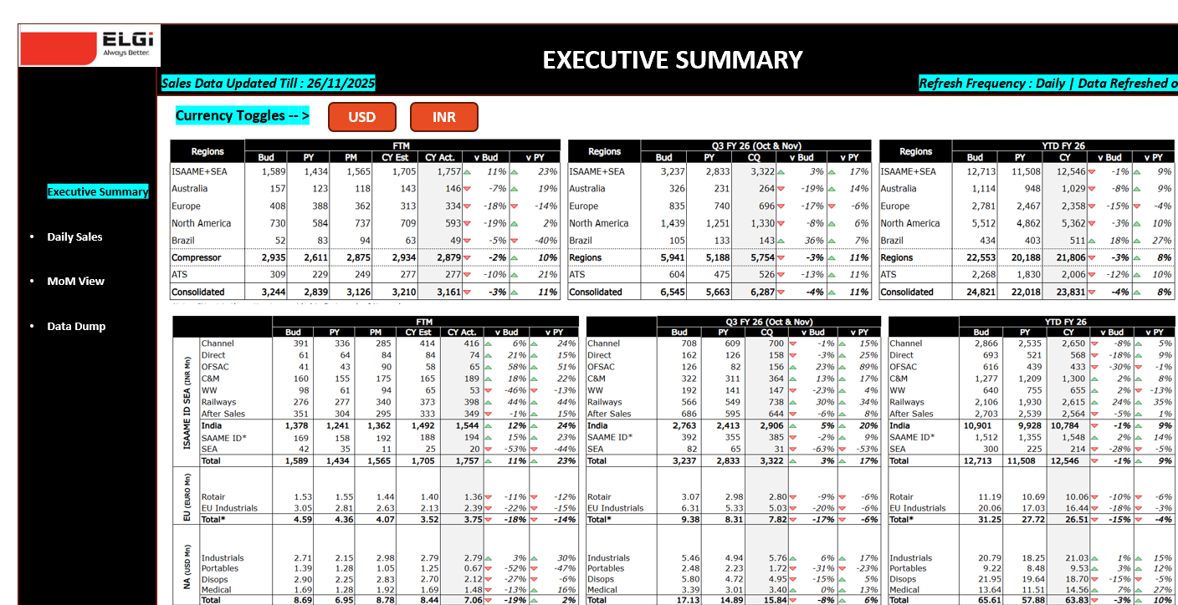




Global Daily Sales Dashboard – Target Architecture
SOURCE SYSTEMS
DATA INGESTION & STAGING
DATA WAREHOUSE & SEMANTIC LAYER
VISUALIZATION & CONSUMPTION
LN On Prem
Storage
India
Australia
ATS
Brazil
Gulf
Indonesia
Malaysia
ADF ETL
Immutable Raw Zone
Landing + Bronze
Curated Warehouse
PowerBi Service and App
Pentaho ETL
Slowly chaining dims (SCD)
Period Tables (Calendar)
Reconciliation
LN CLoud
NA
Europe
Rotair
Staging
Navision
Stored Procedures / Views
Clean
Harmonize
Data Match
Audit & Logging
Refresh : Daily 9am IST
Executive Summary
Daily Sales
Month on Month View
Data Dump
Publish as part of a consolidated streamlined PowerBI app
Pulford
MASTERS
PowerBI Dataset & Data Flows
Sharepoint
Metadata Store (Future)
Centralized Business Logic
Period DAX, Aggregation
Forex Conversion
Star schema, conformed dims
Row Level Security (RLS)
Budget
Forecast
Manual JE
Forex
Data dictionaries
Lineage + Quality Rules
Pipeline Config
Data Owners : Finance
RLS / DL Master
Partially Automated
Fully Automated

Slide 5
Under Discussion
Global Daily Sales Dashboard Architecture
SOURCE SYSTEMS
DATA INGESTION & STAGING
DATA WAREHOUSE & SEMANTIC LAYER
VISUALIZATION & CONSUMPTION
LN On Prem
India
Australia
ATS
Brazil
Gulf
Indonesia
Malaysia
ADF ETL
Storage
PowerBi Service and App
Pentaho ETL
Fact Tables
Immutable Raw Zone
Landing + Bronze
LN CLoud
NA
Europe
Rotair
Staging & Warehouse
PowerBI Dataset & Data Flows
Stored Procedures / Views
Clean
Harmonize
Data Match
Centralized Business Logic
Period DAX, Aggregation
Forex Conversion
Star schema, conformed dims
Row Level Security (RLS)
Navision
Refresh : Daily 9am IST
Executive Summary
Daily Sales
Month on Month View
Data Dump
Publish as part of a consolidated streamlined PowerBI app
Pulford
MASTERS
Sharepoint
Budget
Forecast
Manual JE
Forex
Data Owners : Finance
RLS / DL Master
Partially Automated
Fully Automated

Slide 6

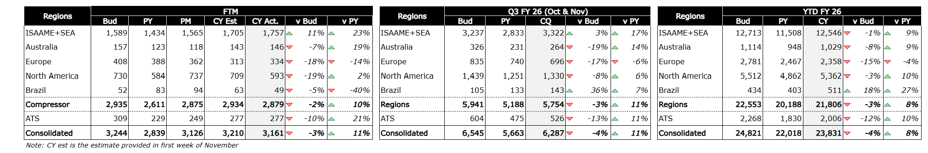
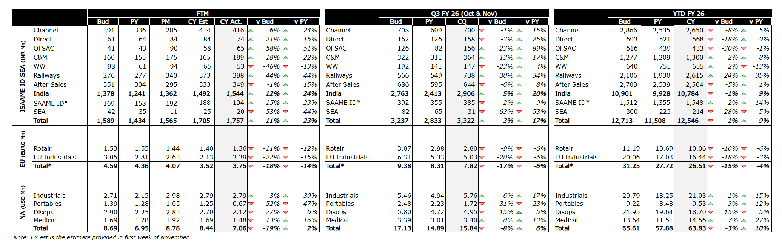
EXECUTIVE SUMMARY
Dashboard Wireframe (1/4)
Illustrative: The following screenshots represent the current Excel-based reports. The corresponding Power BI dashboards will be designed to closely replicate these views, subject to Power BI visualization capabilities, data modeling constraints, and performance considerations.
Sales Data Updated Till : 26/11/2025
Refresh Frequency : Daily | Data Refreshed on
NOTES:
Enable RLS : DL User Group Master
Currency Toggles -- >
USD
INR
Executive Summary
Daily Sales
MoM View
Data Dump for SS
For Budget & Forecast Data : Contact <>
For Sales Data : Contact <>
Data Source :
Raise Tickets <here> for data issues & change requests

Slide 7
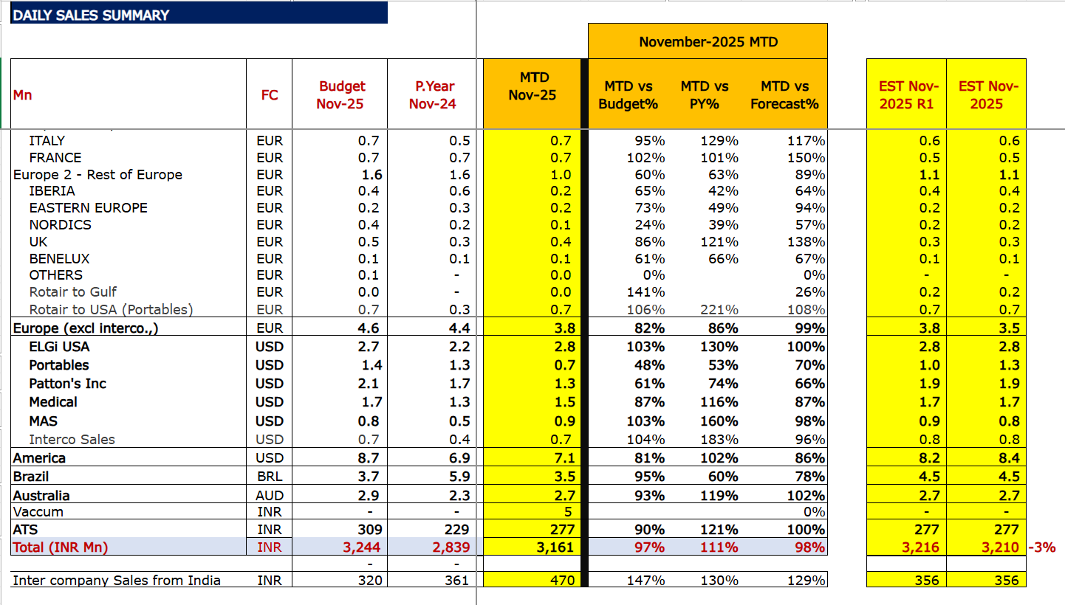
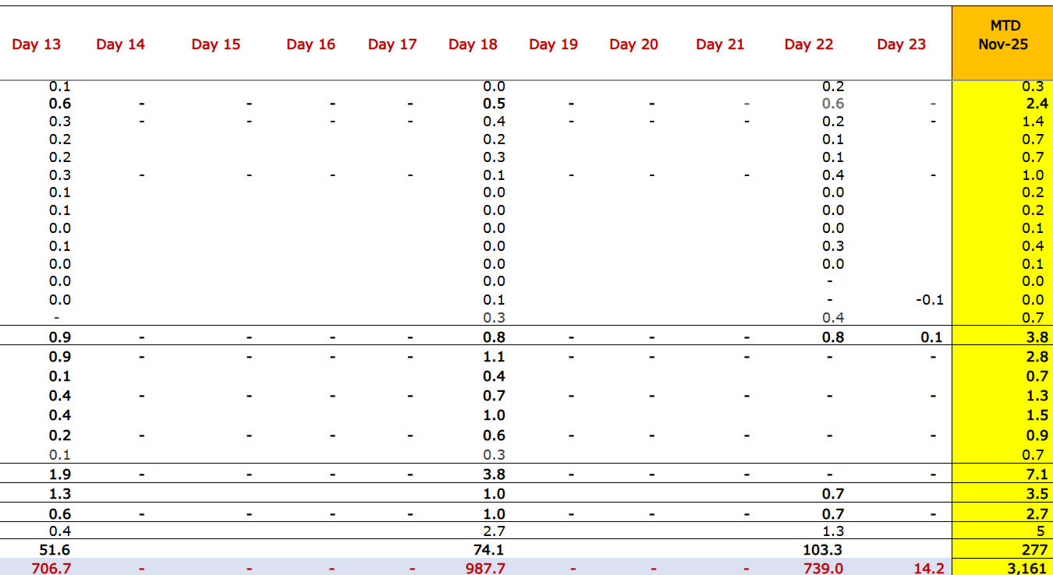
DAILY SALES SUMMARY
Dashboard Wireframe (2/4)
Illustrative: The following screenshots represent the current Excel-based reports. The corresponding Power BI dashboards will be designed to closely replicate these views, subject to Power BI visualization capabilities, data modeling constraints, and performance considerations.
Sales Data Updated Till : 26/11/2025
Refresh Frequency : Daily | Data Refreshed on: (UTC)
NOTES:
Enable RLS : DL User Group Master
Drilldown – expand all as in excel
Local Filter Month: Default to be published per latest date
Include tool tips for definitions and calculations
Local Filter -- >
Month
Tiles for Total in INR -- >
Budget Nov-25 3,244 | P.Year Nov-24 2,839
MTD Nov-25 3,161
MTD vs Budget% 97% | MTD vs PY% 111% | MTD vs Forecast% 98%
Calendar Prop 100% | Achievement % 97%
Executive Summary
Daily Sales
MoM View
Daily Dump for SS
Day 1 – Day 30 Monthly Collapsible
For Budget & Forecast Data : Contact <>
For Sales Data : Contact <>
Data Source :
Raise Tickets <here> for data issues & change requests

Slide 8
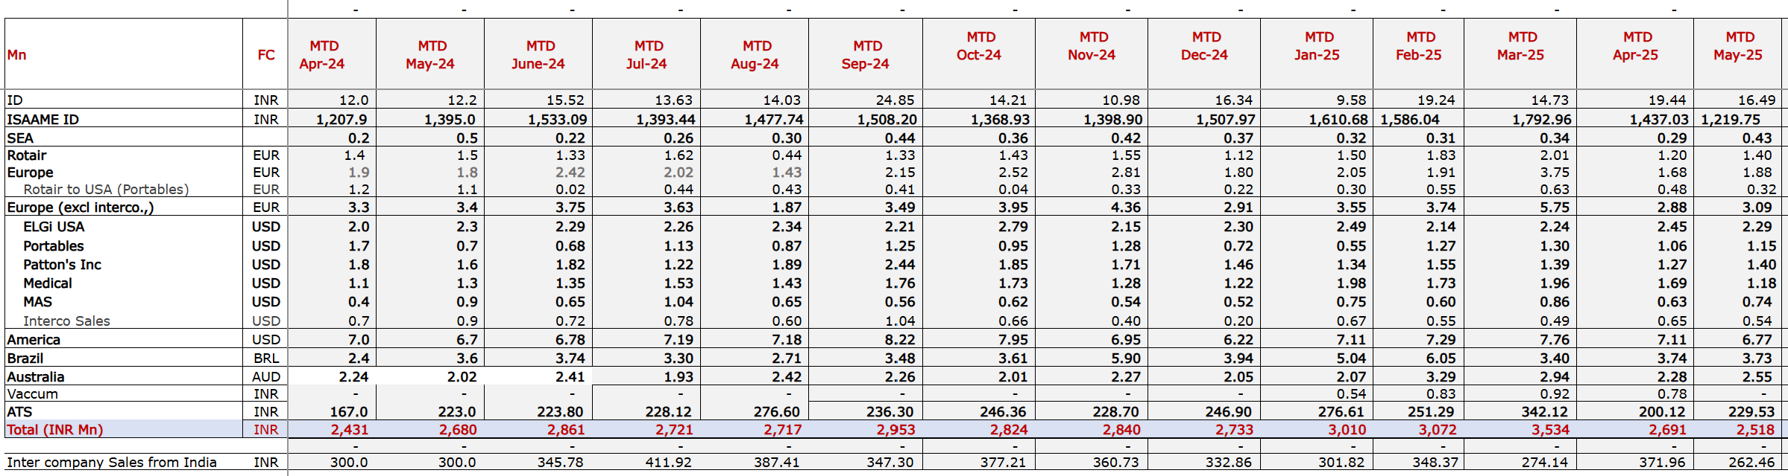
Month on Month
Dashboard Wireframe (3/4)
Illustrative: The following screenshots represent the current Excel-based reports. The corresponding Power BI dashboards will be designed to closely replicate these views, subject to Power BI visualization capabilities, data modeling constraints, and performance considerations.
Sales Data Updated Till : 26/11/2025
Refresh Frequency : Daily | Data Refreshed on
NOTES:
MoM view – Running 12 months
Check if this can be accommodated in the daily sales view
Executive Summary
Daily Sales
MoM View
Daily Dump for SS
For Budget & Forecast Data : Contact <>
For Sales Data : Contact <>
Data Source :
Raise Tickets <here> for data issues & change requests

Slide 9
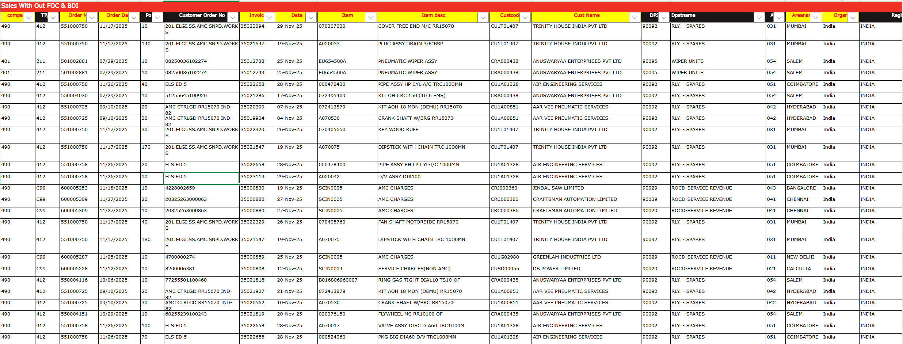
DAILY DATA DUMP FOR SELF SERVICE
Dashboard Wireframe (4/4)
Illustrative: The following screenshots represent the current Excel-based reports. The corresponding Power BI dashboards will be designed to closely replicate these views, subject to Power BI visualization capabilities, data modeling constraints, and performance considerations.
Sales Data Updated Till : 26/11/2025
Refresh Frequency : Daily | Data Refreshed on
NOTES:
Data – daily ( 1 day)
Organ – should include option for “ all ‘”
Local Filter -- >
ORGAN
Executive Summary
Daily Sales
Budget vs Forecast
Daily Dump for SS
For Budget & Forecast Data : Contact <>
For Sales Data : Contact <>
Data Source :
Raise Tickets <here> for data issues & change requests

Slide 10
Annexure

Slide 11
Global Sales Reporting – Data Ingestion Plan
Entity | Data Source | Periodicity | Action Item | Status | Requested On | Requested By Date | IT Resource
Elgi India | IT Feeds from LN | Daily | IT to create data frames as per requirement |  |  |  | Vasanth
North America |  | Daily | Prakash – GL session Nicole – BRs / match sales numbers |  |  |  | Prakash
Rotair | IT Feeds from LN | Daily | IT to build the data feeds based on the LN procedures shared by Luca Prakash is working on the LN procedures |  |  |  | Prakash
Europe Industrials |  | Daily | 1st option – once NA LN logic is build, replicate for Europe 2nd option – place existing files on sharepoint and link to PBI – Vasanth |  |  |  | Option 1 : Prakash Option 2 : Vasanth
Pulford | Navison – Dependency | Daily | Krishna to setup connects - Dipali and Ishwetha on BRs In parallel, Get dataset and report access |  |  |  | Steve (Dipali)
Elgi Australia | IT Feeds from LN | Daily | IT to create data frames as per requirement Check with Deepa – local currency vs INR ( eg – Malaysia) |  |  |  | Vasanth
ATS | IT Feeds from LN | Daily
Brazil | IT Feeds from LN | Daily
Gulf | IT Feeds from LN | Daily
Indonesia | IT Feeds from LN | Daily
Elgi Malaysia | IT Feeds from LN | Daily
Budget – 2 years ( Monthly) | Static File | One Time - BoY | IT to give the format for the static file – created & aligned with BU Finance to update and own refresh |  |  |  | Vasanth
Forecast – Monthly (YTD – with 3 revisions) | Static File | Monthly | IT to give the format for the static file – created & aligned with Finance to update and own refresh |  |  |  | Vasanth
Fx Rate Calculator | Static File | One Time - BoY | IT to give the format for the static file – created & aligned with Finance to update and own refresh |  |  |  | Vasanth
DL – User Group | Static File | As Required | IT to give the format for the static file – created & aligned with Finance to update and own refresh |  |  |  | Vasanth

